Slide 1
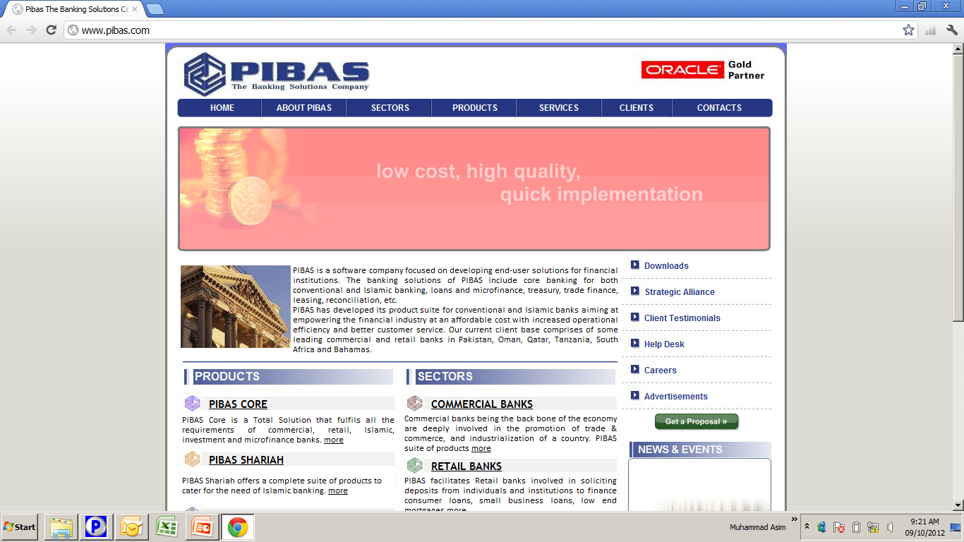
Standing Instructions
Standing Instructions

Slide 2
Contents
Standing Instructions
What is the definition of “Standing Instructions”
Standing Instructions Addition
Standing Instruction Maintenance / Inquiry
Standing Instructions Review
Standing Instruction Maintenance Report
Standing Instructions Outstanding Report

Slide 3
What is the definition of “Standing Instructions”
Standing Instructions
As name suggests, “Standing” means Permanent. So these instructions are the permanent and one time instructions of a customer (s) wherein Financial Transactions are executed as per customer request. Before computerized banking, this activity was done by banks manually by maintaining manual registers. Now this activity can be done by system automatically as per parameters defined by user according to customer need / request. The major parts of a customer “Standing Instructions” could be Period / Frequency, Amount and Target Account etc.

Slide 4
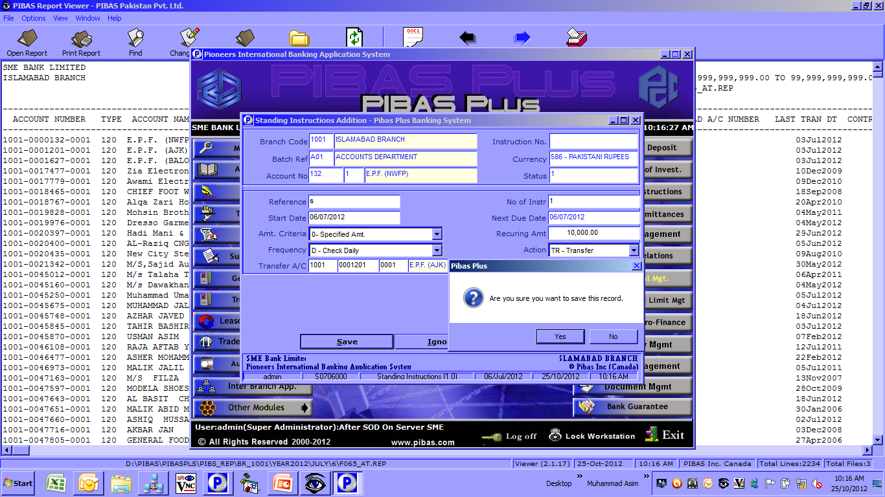
Standing Instructions Addition
Standing Instructions
How To Process / Important Points To Be Noted Before This Option
Both Accounts i.e. Internal or Customer could be used but usually banks allow this facility for Customer Accounts
No. of Instructions can create multiple instances
If Start Date is given 06/07/2012 so the automatic activity will be performed during end of the day processing
Four types of Amount Criteria are available.
Frequency tells system as when this activity has to be performed
In Centralized Environment, target Account could be online, means amount can be transferred to an account that is maintained by some other branch
Same accounts are not allowed

Slide 5
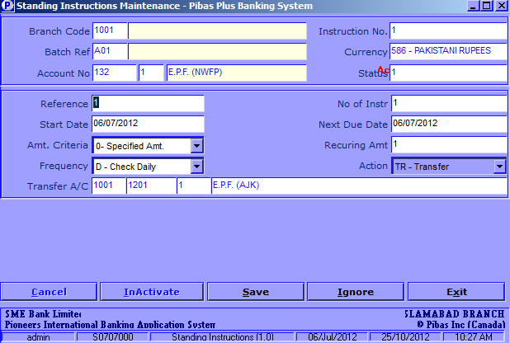
Standing Instructions
Standing Instruction Maint. / Inquiry
How To Process / Important Points To Be Noted Before This Option
Here a Standing Instructions can be Viewed, Cancelled, Inactivated and Changed.

Slide 6
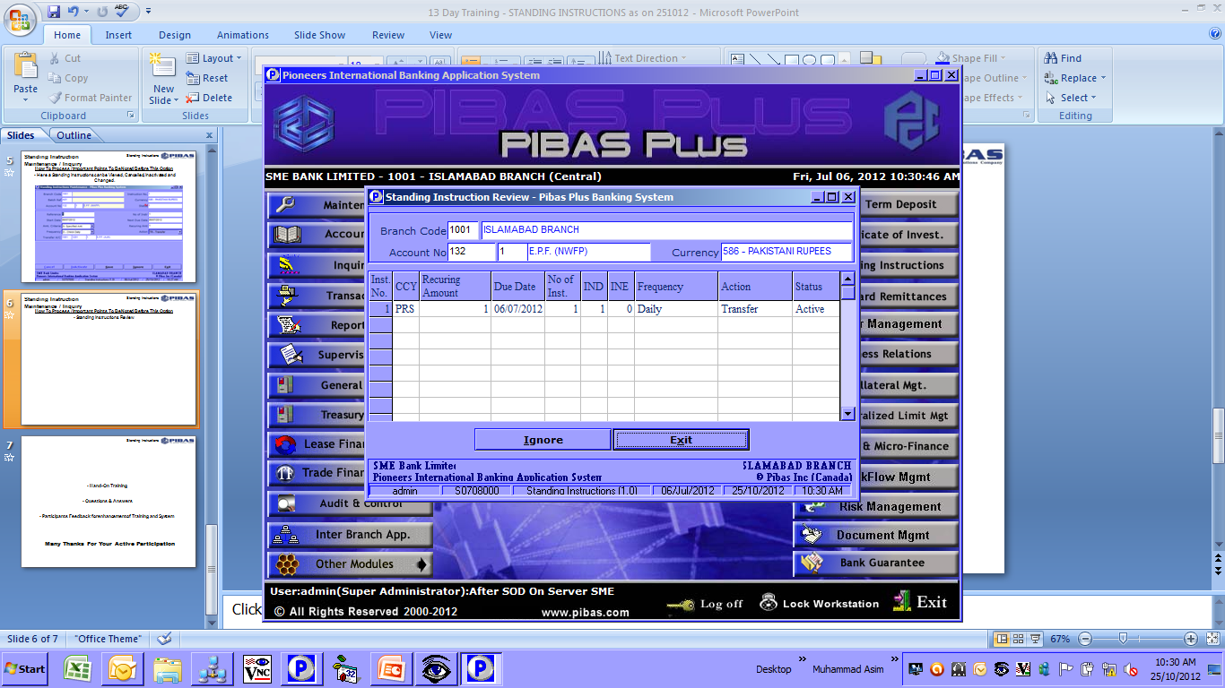
Standing Instructions Review
Standing Instructions
How To Process / Important Points To Be Noted Before This Option
Here all Standing Instructions of a customer could be viewed

Slide 7
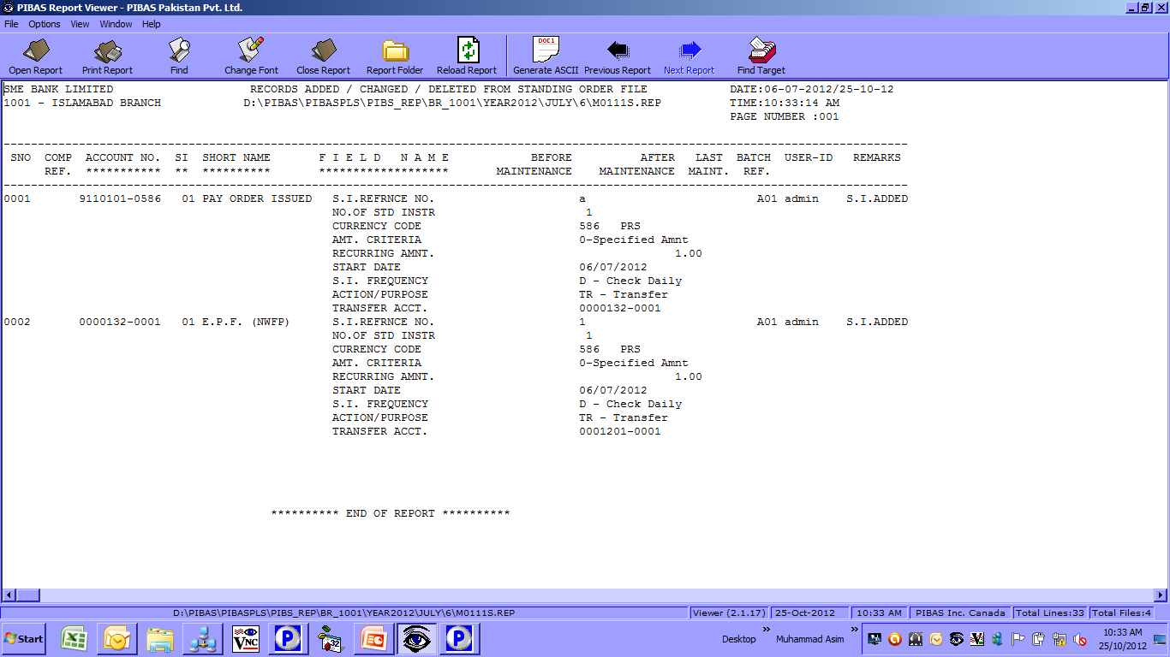
Standing Instructions
Standing Instruction Maint. Report
How To Process / Important Points To Be Noted Before This Option
This report shows all records during a day (Added / Changed / Deleted etc.)

Slide 8
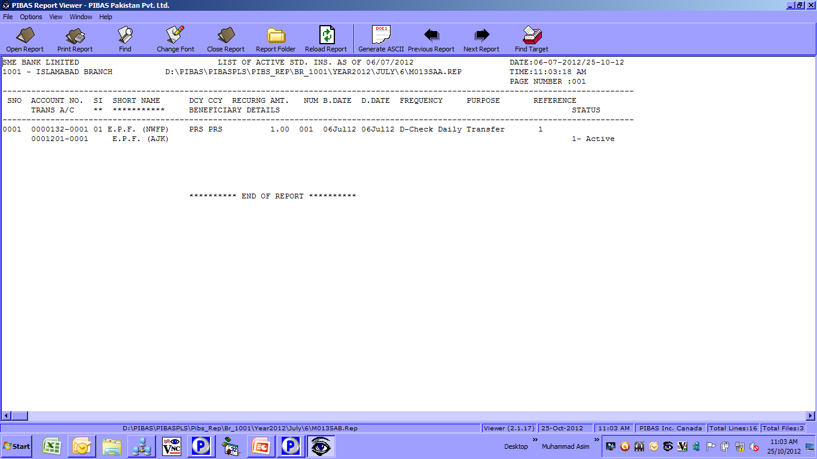
Standing Instructions
Standing Instructions O/s Report
How To Process / Important Points To Be Noted Before This Option
This report shows all outstanding Standing Instructions Details.

Slide 9
Standing Instructions
Hand-On Training
Questions & Answers
Participants Feedback for enhancement of Training and System
Many Thanks For Your Active Participation

